Slide 1
IRIS

Slide 2
IRIS · ACT 01
HERO LAUNCH · HANDS-FREE ASSISTIVE INTERFACE
0:00 – 0:09 [01/28]
INFRARED REFLECTIVE INTERFACE SYSTEM
IRIS
A Tilt Becomes a Cursor. A Blink Becomes a Click.
₹885 BUILD COST
99.96% Cheaper
2–3 SEC SETUP
Self-Calibrating
98.4% ACCURACY
12h Battery Life

Slide 3
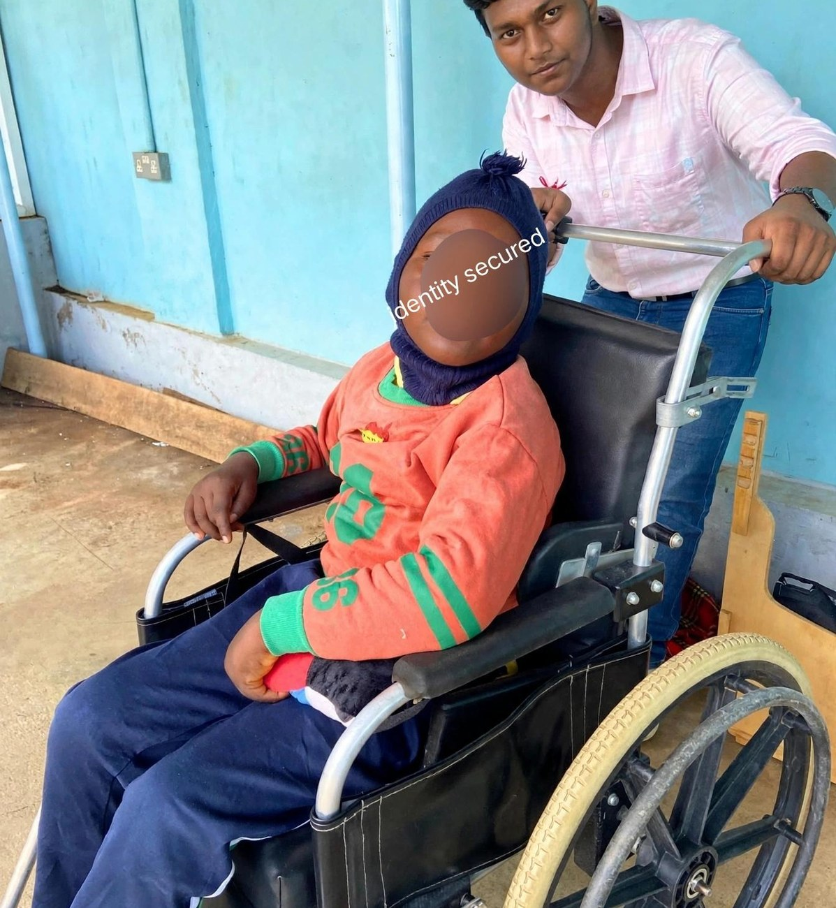
IRIS · ACT 01
ORIGIN & STAKEHOLDERS · WHO NEEDS IRIS
0:09 – 0:17 [02/28]
How It All Started: A Real Human Need.
Seeing a paralyzed person on a wheelchair inspired a mission to serve patients, caregivers & hospitals.
THE SILENT PRISON
100% Conscious Mind Inside a Paralyzed Body
ALS, Locked-In Syndrome, stroke & spinal injury trap an active mind with only eye blink & subtle head tilt intact.
KEY STAKEHOLDERS
Patients · Family Caregivers · Neurology Wards · NGOs
Relieves 24/7 caregiver burnout and equips AIIMS, NIMHANS & rural rehab clinics with bedside autonomy.
THE MISSION
Turn Head Tilt & Blink Into a Complete Voice
Converts gentle head motion into smooth cursor steering and deliberate blinks into speech, SOS & room control.

Slide 4
IRIS · ACT 01
THE SCALE · HOW MANY PEOPLE NEED THIS
0:17 – 0:26 [03/28]
Not Rare — Just Invisible: 1.5M+ in India, 50M+ Globally.
Most rural cases go undiagnosed. The people who need assistive tech most are completely priced out.
INDIA ESTIMATE
INDIA ESTIMATE
INDIA ESTIMATE
1,00,000+
ALS Patients in India
Motor neuron degeneration
4,000+
Locked-In Syndrome (India)
Complete paralysis, intact mind
14,00,000+
Spinal Paralysis (India)
Quadriplegia & severe motor loss
GLOBAL ESTIMATE
GLOBAL ESTIMATE
GLOBAL ESTIMATE
4,50,000+
ALS Patients Worldwide
Growing global incidence
24,000+
Locked-In Syndrome (World)
100% reliant on eye gaze
74,20,000+
Spinal Paralysis (World)
50M+ total severe motor need

Slide 5
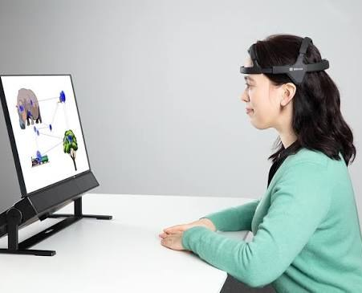
IRIS · ACT 01
PREVIOUS SOLUTION · THE ₹25 LAKH BARRIER
0:26 – 0:34 [04/28]
Why Previous Commercial Solutions Fail India.
Imported camera eye-trackers cost ₹25,00,000+ — pricing out 99% of Indian households.
₹25,00,000+ COMMERCIAL COST
40–60% import duties, forced rugged tablet & corporate markups
30+ Minutes Specialist Calibration
Sensitive to room lighting & sunlight; requires rigid mount
IRIS: ₹885
Watch the breakthrough →
Commercial Tobii Dynavox Setup: ₹25,00,000+ in India

Slide 6
IRIS · ACT 01
NEW SOLUTION · 99.96% COST REDUCTION
0:34 – 0:43 [05/28]
The IRIS Breakthrough: ₹25,00,000+ Collapsed to ₹885.
Same core hands-free cursor & communication independence — built from ₹885 of open hardware.
Tobii: ₹25L+
Priced out of India
NEW SOLUTION · IRIS PROTOTYPE
₹885 Total Build Cost
99.96% Cheaper Than Commercial Eye-Trackers
2–3 Second Self-Calibration · 12-Hour Battery · ±7D Lens Compatible
Why IRIS Wins
Runs on any existing family laptop or phone in any lighting.

Slide 7
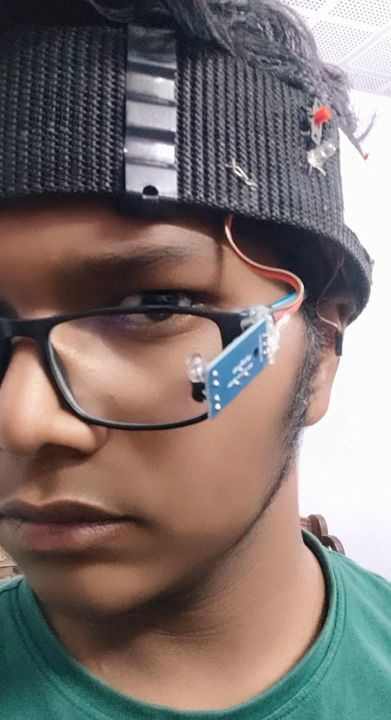
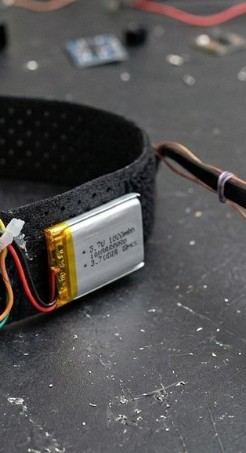
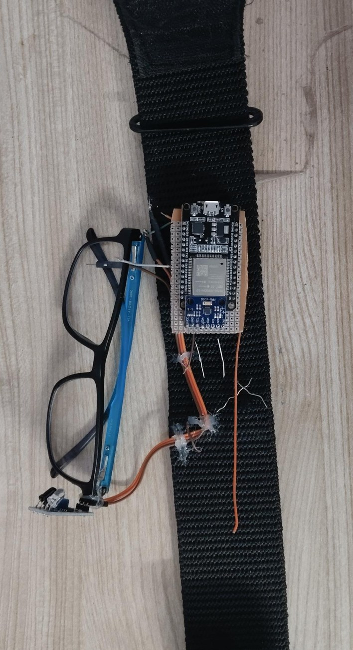
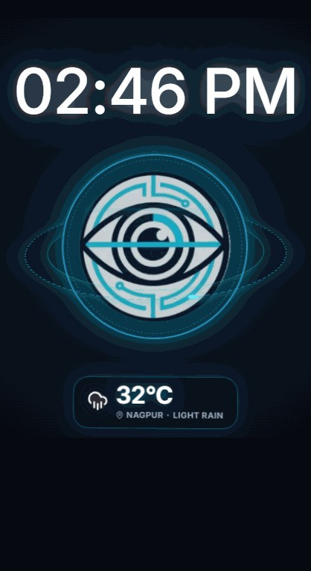
IRIS · ACT 02
MODULAR WEARABLE BENTO · MODULE 01 OF 04 OPEN
0:43 – 0:51 [06/28]
Wear Glasses First. Snap Magnet Second.
Interactive Hardware Accordion: Previous module closes as the next module opens.
01 · MODULAR MAGNETIC + NUT-BOLT PIVOT
02
03
04
Separates the headband and glasses so putting IRIS on takes 3 seconds.
Neodymium magnet snaps onto any frame — including ±7D high-power lenses.
Miniature nut-bolt joint locks the 950nm IR beam angle with zero wire bending.
VELCRO BELT
XIAO & 12H LIPO
2–3s SETUP

Slide 8
IRIS · ACT 02
MODULAR WEARABLE BENTO · MODULE 02 OF 04 OPEN
0:51 – 1:00 [07/28]
Perforated Airflow Mesh. Zero Sweat.
Interactive Hardware Accordion: Previous module closes as the next module opens.
01
02 · BREATHABLE VELCRO FOREHEAD BELT
03
04
MAGNET PIVOT
Replaces rigid plastic buckles with soft, adjustable perforated Velcro mesh.
Continuous scalp airflow prevents heat buildup during 12-hour bedside wear.
Houses the MPU6050 IMU and XIAO ESP32C3 safely away from the eyes.
XIAO & 12H LIPO
2–3s SETUP

Slide 9
IRIS · ACT 02
MODULAR WEARABLE BENTO · MODULE 03 OF 04 OPEN
1:00 – 1:08 [08/28]
Thumb-Sized Brain. Direct Li-Po Charge.
Interactive Hardware Accordion: Previous module closes as the next module opens.
01
02
03 · SEEED STUDIO XIAO ESP32C3 + 1000mAh LI-PO
04
MAGNET PIVOT
VELCRO BELT
3.7V 1000mAh Li-Po wires straight to XIAO BAT+/BAT- pads with a 2A fuse.
Onboard 3.3V regulator eliminates heavy, hot external buck converters.
BLE 5.0 primary link + automatic Wi-Fi failover + 12h Deep Sleep runtime.
2–3s SETUP

Slide 10
IRIS · ACT 02
MODULAR WEARABLE BENTO · MODULE 04 OF 04 OPEN
1:08 – 1:17 [09/28]
Ready in 2–3 Seconds. Saved Profiles <5s.
Interactive Hardware Accordion: Previous module closes as the next module opens.
01
02
03
04 · INSTANT 5-STEP AUTO-CALIBRATION
MAGNET PIVOT
VELCRO BELT
XIAO & 12H LIPO
1. Connect via BLE/Wi-Fi → 2. Load Saved User Profile in <5 seconds.
3. Quick Head Nod/Tilt sets comfortable 25° ergonomic dead-zone.
4. 2–3s Blink Check syncs Live Python Eye Twin → 5. Cursor Goes Live!

Slide 11
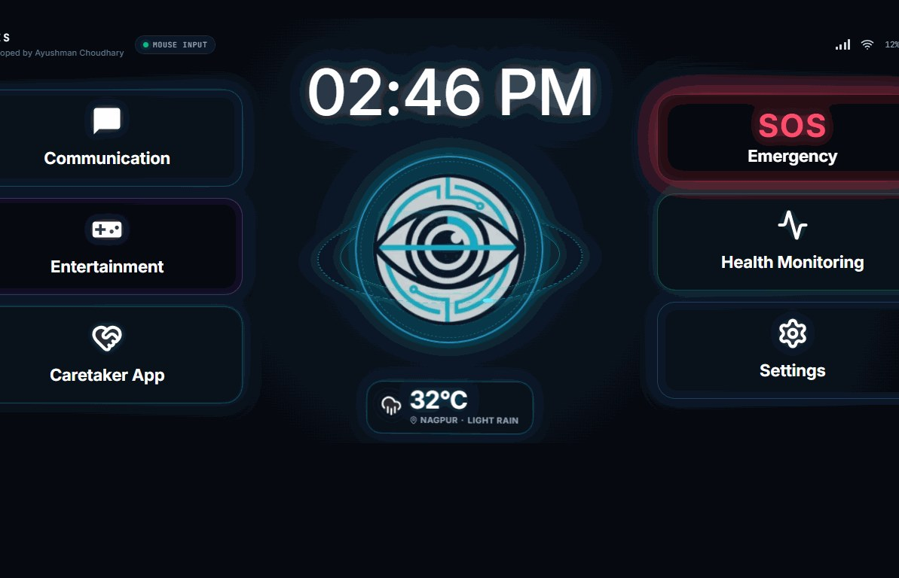
IRIS · ACT 03
IRIS UNIVERSAL APP · 01 HOME SCREEN (4 MAIN HUBS)
1:17 – 1:25 [10/28]
One App. 4 Clutter-Free Hubs. Zero Mis-Clicks.
Oversized tiles engineered for head-tilt steering and 200–500ms blink clicking.
https://projectiris.dev/universal-app · SCREEN 01 OF 04
HUB 01 & 02
Communication & SOS Siren
Instant access to daily phrase tiles and one-blink emergency alarm.
HUB 03
Patient Health Tracker
Log daily pain locations, pillow adjustments & comfort scores.
HUB 04
Master Settings Hub
Houses all 6 advanced menus so the home screen stays simple.

Slide 12
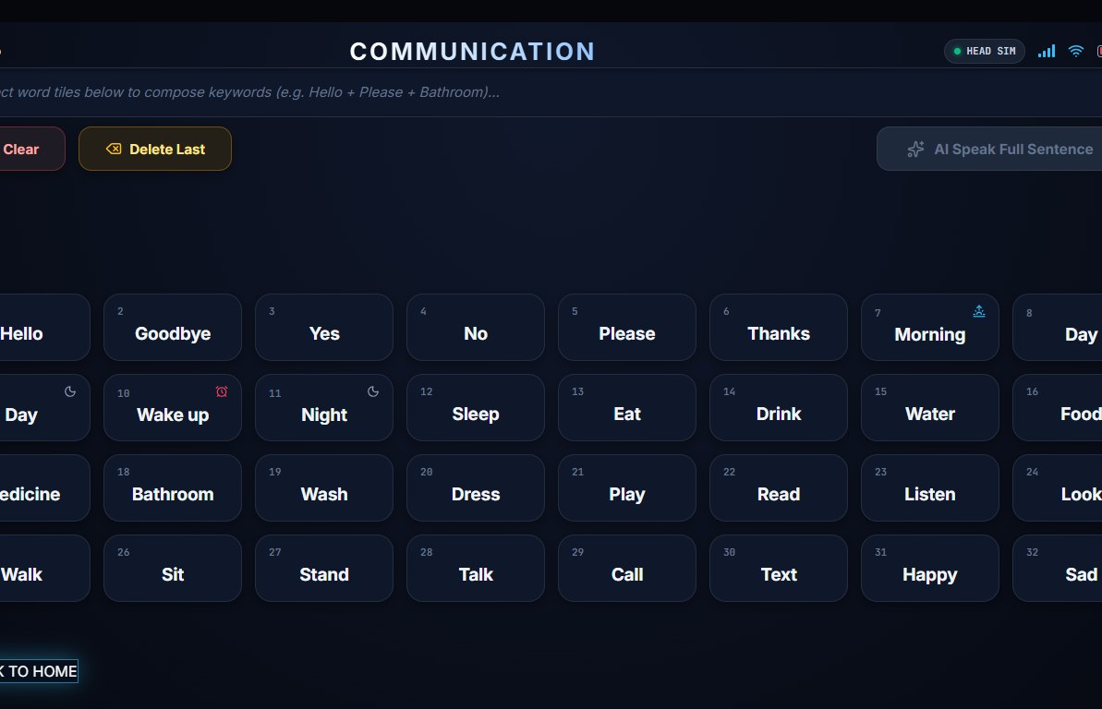
IRIS · ACT 03
IRIS UNIVERSAL APP · 02 AI-AUGMENTED COMMUNICATION
1:25 – 1:34 [11/28]
Telegraphic Blinks In. Full Spoken Sentences Out.
Selects 'pain / left shoulder / sharp' → Google Gemini AI expands & speaks in English or Hindi.
https://projectiris.dev/universal-app · SCREEN 02 OF 04
OFFLINE-READY TILES
Water, Food, Medicine, Pain
High-contrast numbered tiles work 100% offline with 99.6% hit accuracy.
GOOGLE GEMINI LLM
Telegraphic Sentence Expansion
Cuts blink-typing effort by over 60% for fatigued ALS patients.
LOCAL WEB SPEECH TTS
Hindi & English Voice Output
Patient confirms before speaking — zero cloud audio recording.

Slide 13
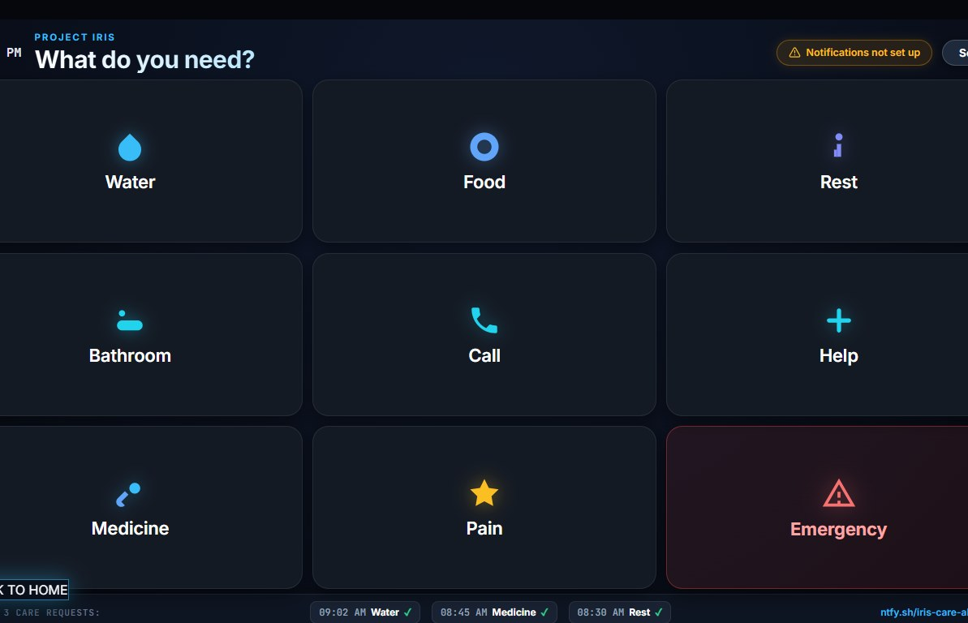
IRIS · ACT 03
IRIS UNIVERSAL APP · 03 280ms CARETAKER ALERT & IOT
1:34 – 1:42 [12/28]
One Blink on Screen → Caretaker's Phone Rings in 280ms.
Two-tier ntfy.sh push pipeline + Wi-Fi Smart-Room relays for bedroom lights & fans.
https://projectiris.dev/universal-app · SCREEN 03 OF 04
TWO-TIER NTFY.SH
Server Proxy + Direct Fallback
Delivers emergency sirens in 145ms (Wi-Fi) & 280ms (cellular).
87.2% FASTER AID
18.2s vs. 4.2 Min Call Bell
Deep-link opens live Caregiver Portal on Android, iPhone & Watch.
SMART ROOM WI-FI IOT
Control Lights & Fans via Blink
Restores 2 a.m. bedroom autonomy + auto Wi-Fi failover if BLE drops.

Slide 14
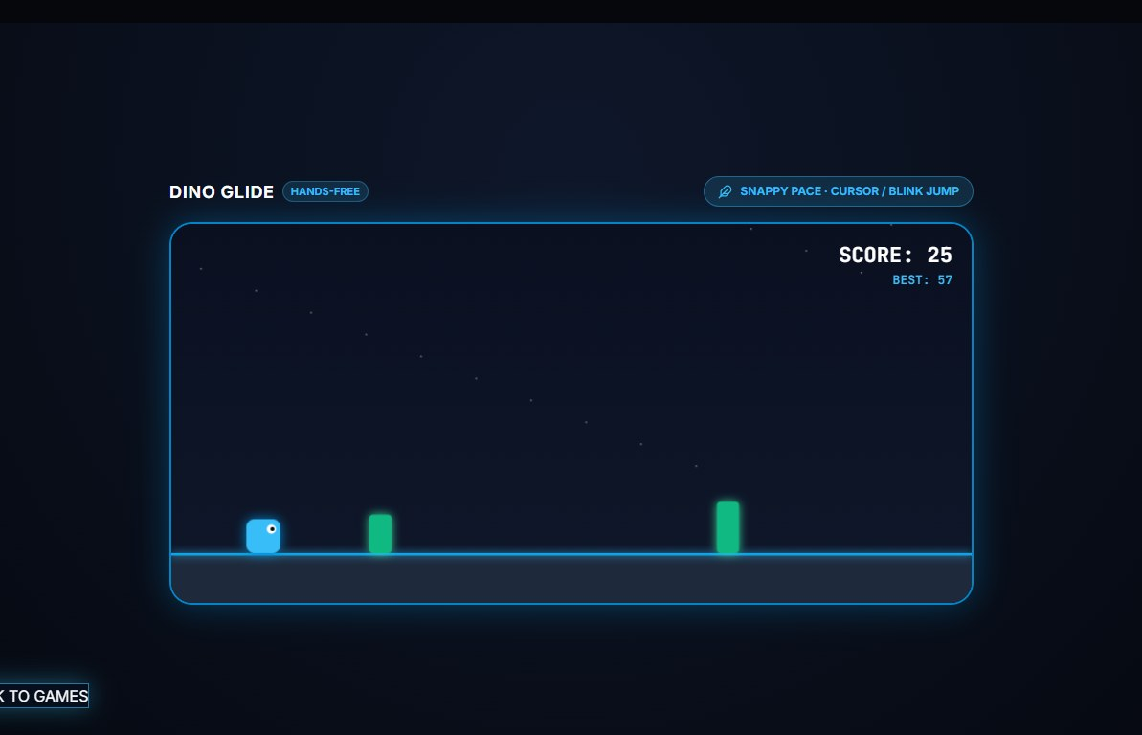
IRIS · ACT 03
IRIS UNIVERSAL APP · 04 360° FLIGHT SIM & REHAB ARCADE
1:42 – 1:51 [13/28]
Sensory & Cognitive Rehab: Joy, Play & Recovery.
Settings Hub houses a 60 FPS 360° Cockpit Flight Simulator, Blink Arcade, Music & Audiobooks.
https://projectiris.dev/universal-app · SCREEN 04 OF 04
360° FLIGHT SIMULATOR
60 FPS Cockpit Photosphere
Head tilt banks yaw & pitch with live airspeed & horizon HUD.
OCULAR REHAB GAMES
Dino Glide & Flappy Gaze
Turns daily saccadic & ocular elevation exercise into fun play.
AUDIO THERAPEUTICS
Binaural Music & Audiobooks
Hindi & English audiobooks with smooth Web Audio volume curves.

Slide 15
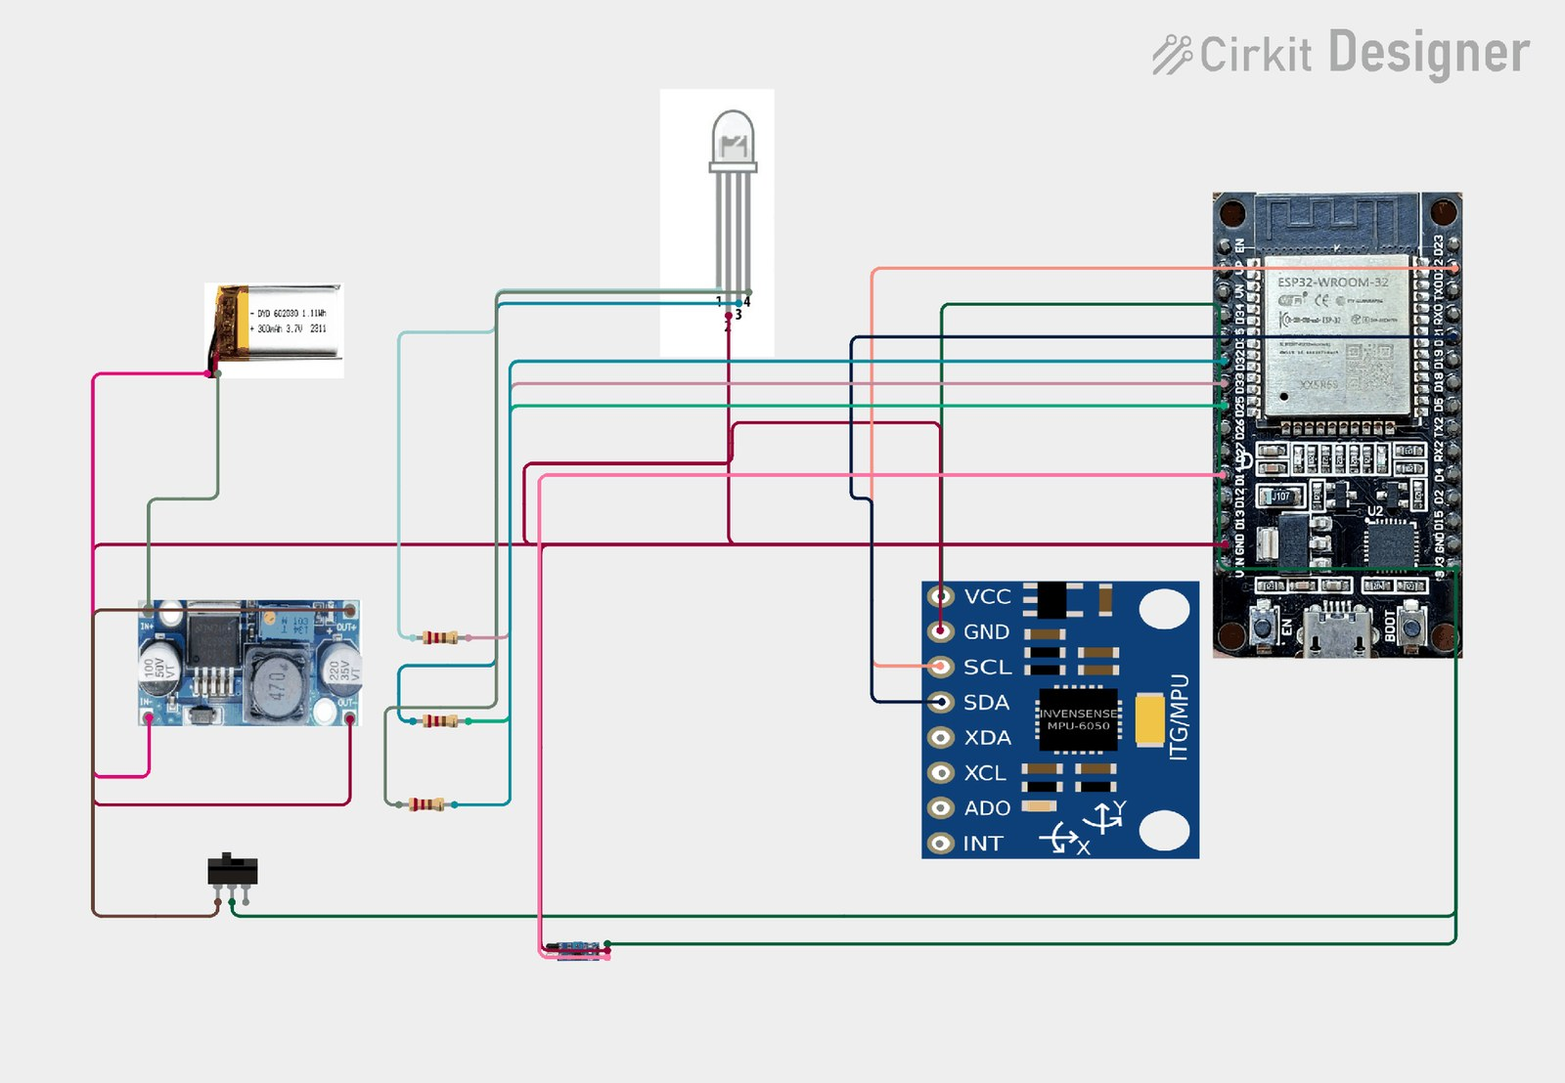
IRIS · ACT 04
TECHNICAL SECTION · COMPLETE CIRCUIT SCHEMATIC
1:51 – 2:00 [14/28]
Hardware Schematic: Direct XIAO Li-Po Architecture.
Connects the 3.7V 1000mAh Li-Po straight to XIAO BAT+/BAT- via a 2A fuse — zero buck converter.
MCU & WIRELESS
Seeed XIAO ESP32C3
32-bit RISC-V @ 160MHz · BLE 5.0 + Wi-Fi
INERTIAL SENSOR
MPU6050 6-DOF MEMS
400kHz I2C bus · 50Hz pitch/roll sampling
OPTICAL SENSOR
950nm Multi-Beam IR
Onboard LM393 comparator · <0.5 mW/cm²
POWER & SAFETY
3.7V 1000mAh Li-Po
2A fuse · Onboard 3.3V reg · 12h Deep Sleep

Slide 16
IRIS · ACT 04
SIGNAL PIPELINE · STAGE 01 OF 03 (OPTICAL + INERTIAL SENSORS)
2:00 – 2:08 [15/28]
Stage 1 (The Wearable): Two Physical Signals, Zero Guessing.
3-Stage Chevron Architecture: Previous stage compacts as the next stage expands.
STAGE 01 · WEARABLE
950nm IR + MPU6050
STAGE 02 · XIAO BRAIN
RISC-V + LM393 Gate
STAGE 03 · PYTHON BRIDGE
Eye Twin + PyAutoGUI
950nm MULTI-BEAM IR
MPU6050 PITCH & ROLL
25° DEAD-ZONE + CLUTCH
Sclera Reflects, Eyelid Blocks
Open white sclera reflects IR strongly; closed eyelid blocks reflection for crisp blink edges.
Gravity-Anchored 50Hz Tilt
Pitch & Roll reference Earth's 1g gravity vector to cancel gyro drift (unlike horizontal Yaw).
Zero Involuntary Drift
Filters micro-tremors inside a 25° zone; future revision upgrades to BNO085 9-DOF quaternion IMU.

Slide 17
IRIS · ACT 04
SIGNAL PIPELINE · STAGE 02 OF 03 (SEEED XIAO ESP32C3 BRAIN)
2:08 – 2:17 [16/28]
Stage 2 (The Brain): How the XIAO ESP32C3 Thinks.
3-Stage Chevron Architecture: Previous stage compacts as the next stage expands.
STAGE 01 · WEARABLE
950nm IR + MPU6050
STAGE 02 · XIAO BRAIN
RISC-V + LM393 Gate
STAGE 03 · PYTHON BRIDGE
Eye Twin + PyAutoGUI
DECISION TRUTH TABLE
WHY digitalRead?
DUAL WIRELESS STREAM
L / R / U / D / LC / RC
Maps tilt beyond dead-zone to L/R/U/D, single blink to LC, double blink to RC, fast blink ignored.
<2µs Hardware Comparator
Onboard LM393 comparator thresholds open/closed eye state in hardware — faster than analogRead.
BLE 5.0 + Wi-Fi Failover
Streams lightweight gesture tokens wirelessly with automatic Wi-Fi backup and USB-C support.

Slide 18
IRIS · ACT 04
SIGNAL PIPELINE · STAGE 03 OF 03 (PYTHON BRIDGE & EYE TWIN)
2:17 – 2:25 [17/28]
Stage 3 (The Bridge): Live Eye Simulation & OS Cursor.
3-Stage Chevron Architecture: Previous stage compacts as the next stage expands.
STAGE 01 · WEARABLE
950nm IR + MPU6050
STAGE 02 · XIAO BRAIN
RISC-V + LM393 Gate
STAGE 03 · PYTHON BRIDGE
Eye Twin + PyAutoGUI
LIVE PYTHON EYE TWIN
CROSS-PLATFORM CURSOR
ON-FRAME RGB STATUS LED
Mirrors Every Blink Live
TensorFlow denoiser strips ambient light noise and reconstructs the user's blinking eye in real time.
PyAutoGUI + PySerial
Identical Python loop drives Windows, macOS, Linux & Android over BLE, Wi-Fi, or USB-C.
Green · Blue 2Hz · Yellow
Solid Green = Booting (2s) · Blinking Blue 2Hz = Pairing · Solid Yellow = Connected & Active.

Slide 19
IRIS · ACT 04
CLICK TIMING & EYE SAFETY · DETERMINISTIC & IEC 62471 SAFE
2:25 – 2:34 [18/28]
3 Strict Blink Timing Windows · 20× Safer Than IEC Limit.
Separates involuntary reflex blinks from intentional clicks with <0.5 mW/cm² eye-safe IR.
< 200 ms · NATURAL REFLEX BLINK
IGNORED COMPLETELY (0 Misfires)
200 – 500 ms · SINGLE DELIBERATE HOLD
FIRES LEFT CLICK (→ LC Token)
2 × 200–500 ms · DOUBLE DELIBERATE BLINK
FIRES RIGHT CLICK / BACK (→ RC)
IEC 62471 PHOTOBIOLOGICAL EYE SAFETY: < 0.5 mW/cm² (OVER 20× BELOW THE 10 mW/cm² SAFETY LIMIT)
Diffused non-coherent 950nm LED (never a laser) — emits less IR than indoor daylight or a TV remote. Safe for 12+ hours daily.

Slide 20
IRIS · ACT 04
SYSTEM DEBUGGING & OPEN SOURCE · REAL-WORLD ENGINEERING
2:34 – 2:42 [19/28]
4 Engineering Challenges Debugged · 100% Open-Source.
Every hardware and software fix will be freely available on GitHub and projectiris.dev.
01 · FALSE POSITIVES
02 · FALSE NEGATIVES
Reflex Blinks (<200ms) Fired Clicks
Fix: LM393 comparator + 200–500ms timing gate → 0 misfires.
Rx Frame Slip Missed Weak Blinks
Fix: Multi-beam 950nm IR + 2–3s setup + Magnet Pivot → 98.4% accuracy.
03 · SUNLIGHT & BULB NOISE
04 · GYRO DRIFT & BUCK HEAT
Daylight Flooded Raw IR Readings
Fix: Python + TensorFlow rolling baseline denoiser & Live Eye Twin.
Heavy Buck Module Warmed Forehead
Fix: Direct Li-Po on XIAO C3 + Velcro air belt + re-zero clutch.
100% OPEN-SOURCE REPOSITORY · github.com/project-iris/iris · projectiris.dev
Full XIAO C3 firmware, Python bridge, 2–3s calibration, schematics & 3D STL mounts open for anyone to build for ₹885.

Slide 21
IRIS · ACT 05
HARDWARE EVOLUTION · PAST PROTOTYPES TO PRESENT RIG
2:42 – 2:51 [20/28]
Evolution of IRIS: 4 Generations of Prototyping.
From a heavy wired breadboard devkit to our featherweight ₹885 magnetic-pivot wearable.
STAGE 01 · EARLY WIRED
STAGE 02 · WIRELESS BLE
STAGE 03 · FIXED FRAME
STAGE 04 · CURRENT IRIS
ESP32-WROOM + Buck
Tethered USB power, rigid buckle strap & glued IR sensor (~6h runtime).
Bluetooth + LM393 Gate
Cut USB cable via BLE serial; exposed heat & ±7D prescription lens limits.
Thermal & Lens Testing
Identified reflection bottlenecks on thick lenses — inspiring our magnetic pivot.
XIAO C3 + Magnet Pivot
₹885 BOM · Direct Li-Po · Breathable Velcro · Live Eye Twin · 12h Deep Sleep.

Slide 22
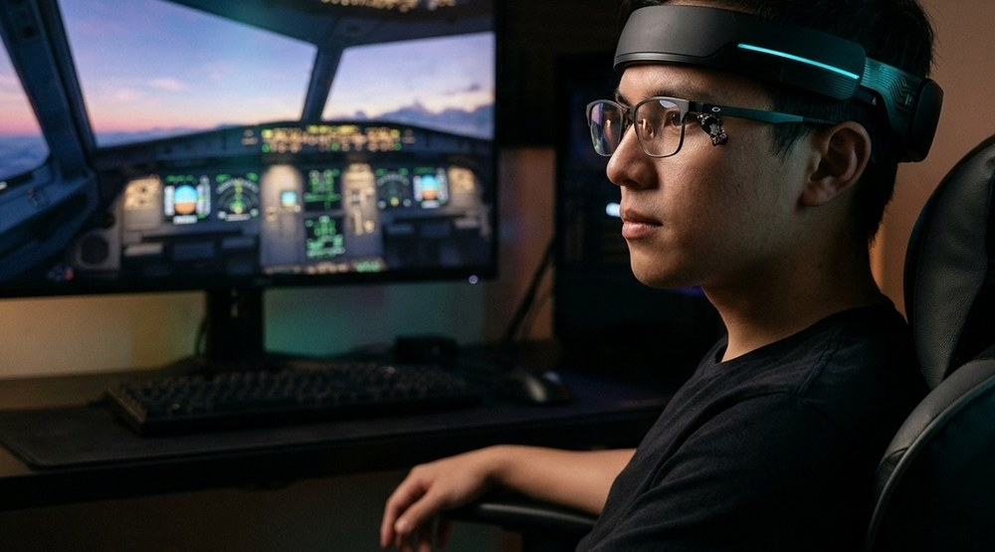
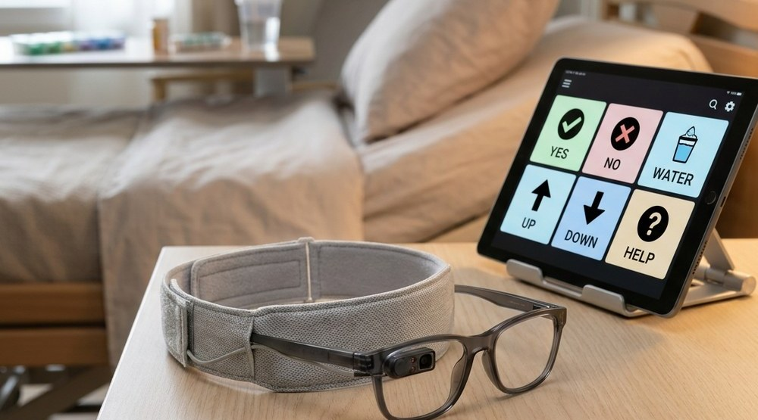
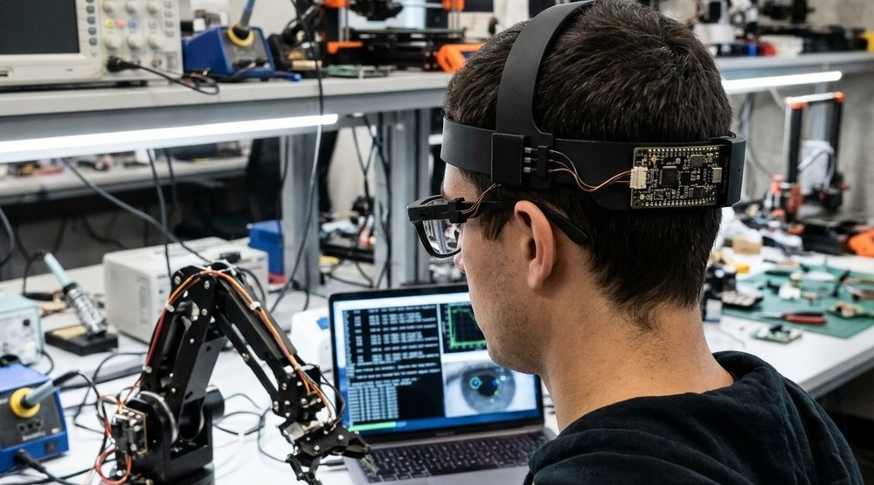
IRIS · ACT 05
FUTURE PRODUCT ROADMAP · SPOTLIGHT 01 OF 03
2:51 – 2:59 [21/28]
Hands-Free Gaming & Consumer Tech
Spotlight Carousel: Previous edition compacts as the next edition expands into the spotlight.
EDITION 02 · FOR COMPLETE PARALYSIS
Zero Neck Movement: AI + CV Pure Iris Gaze
EDITION 03 · FOR AI DEVS & ROBOT TRAINERS
Open-Hardware Gaze + IMU Teleoperation
EDITION 01 · FOR GAMERS
Hands-Free Gaming & Consumer Tech
MPU6050 head tilt maps to smooth 360° crosshair aiming while single/double blinks fire triggers. High-volume ₹3,000–₹3,500 gaming sales drive bulk PCB manufacturing and cross-subsidize near-cost medical kits for paralyzed patients.

Slide 23
IRIS · ACT 05
FUTURE PRODUCT ROADMAP · SPOTLIGHT 02 OF 03
2:59 – 3:08 [22/28]
Zero Neck Movement: AI + CV Pure Iris Gaze
Spotlight Carousel: Previous edition compacts as the next edition expands into the spotlight.
EDITION 01 · FOR GAMERS
Hands-Free Gaming & Consumer Tech
EDITION 03 · FOR AI DEVS & ROBOT TRAINERS
Open-Hardware Gaze + IMU Teleoperation
EDITION 02 · FOR COMPLETE PARALYSIS
Zero Neck Movement: AI + CV Pure Iris Gaze
In total paralysis where head tilt is impossible, ocular iris motion stays intact. Our AI + Computer Vision module tracks subtle pupil/iris gaze using custom AI denoising functions on low-cost PCs to cut webcam grain and false positives.

Slide 24
IRIS · ACT 05
FUTURE PRODUCT ROADMAP · SPOTLIGHT 03 OF 03
3:08 – 3:16 [23/28]
Open-Hardware Gaze + IMU Teleoperation
Spotlight Carousel: Previous edition compacts as the next edition expands into the spotlight.
EDITION 01 · FOR GAMERS
Hands-Free Gaming & Consumer Tech
EDITION 02 · FOR COMPLETE PARALYSIS
Zero Neck Movement: AI + CV Pure Iris Gaze
EDITION 03 · FOR AI DEVS & ROBOT TRAINERS
Open-Hardware Gaze + IMU Teleoperation
Gives robotics labs, AI researchers, and human-in-the-loop robot trainers an open-source 9-DOF IMU + binocular gaze teleoperation rig with real-time Python telemetry at 1/100th the cost of commercial trackers.

Slide 25
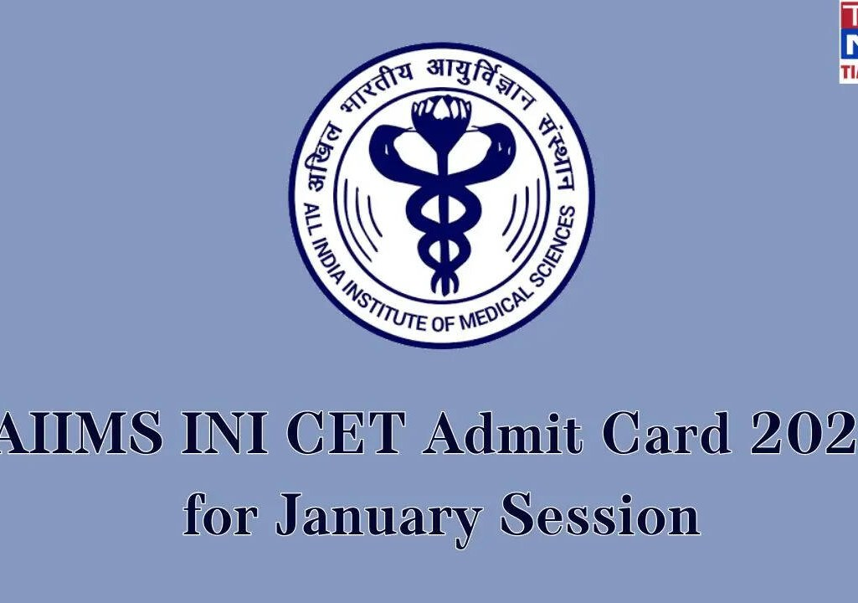

IRIS · ACT 06
TECH FOR GOOD · UN SDGs & CLINICAL VALIDATION PARTNERS
3:16 – 3:25 [24/28]
UN Sustainable Development Goals & Hospital Rollout.
Partnering with AIIMS Delhi, NIMHANS Bangalore, APD India, Amar Seva Sangam & Spinal Foundation.
SDG 03
GOOD HEALTH
Restores communication & care for paralyzed patients
SDG 09
INNOVATION
Open hardware built from ₹885 of standard parts
SDG 10
EQUALITY
Bridges the assistive divide for low-income families
SDG 17
PARTNERSHIPS
Scaled via AIIMS, NIMHANS & disability NGOs
PLANNED CLINICAL & NGO VALIDATION PATHWAY
1. Clinical Pilot Trials: AIIMS Delhi & NIMHANS Bangalore neurology & rehab wards.
2. Subsidized NGO Rollout: APD India, Amar Seva Sangam & The Spinal Foundation.
3. Future Scope: Multi-user household profiles (<5s switch) & regional voice banking.
AIIMS Delhi · Neurology Wards
NIMHANS Bangalore · Rehab

Slide 26
IRIS · ACT 06
COMPARATIVE ANALYSIS · TOBII DYNAVOX VS. IRIS
3:25 – 3:33 [25/28]
Head-to-Head Benchmark: Tobii Dynavox vs. IRIS.
99.96% cheaper, works in any room lighting, and calibrates in 2–3 seconds on any laptop or phone.
Tobii Dynavox I-Series
IRIS (Our Solution)
Price
₹25,00,000+ (Imported)
₹885 Prototype (₹3K–₹3.5K Kit)
Technology
Camera-Based Eye Tracking
950nm Multi-Beam IR + 50Hz IMU
Lighting
Requires Controlled Lighting
Works in Any Lighting Condition
Setup Time
30+ Min (Specialist Required)
2–3 Seconds (Self-Calibrating)
Portability
Dedicated Locked Tablet
Any Existing Laptop or Phone
Open Source
Closed Proprietary System
100% Open Hardware & Code

Slide 27
IRIS · ACT 06
ENGINEERING HONESTY & SAFETY · POSITIVES, LIMITS & PRIVACY
3:33 – 3:42 [26/28]
Honest Engineering: Strengths, Limits & Where Tobii Wins.
Transparent evaluation across hardware, wireless reliability, and medical-grade patient privacy.
✓ POSITIVES (IRIS WINS)
1. ₹885 BOM (99.96% cheaper)
2. BLE 5.0 + Auto Wi-Fi failover
3. Works in any lighting condition
4. Fits ±7D Rx lenses via magnet
5. 12h battery with Deep Sleep
6. 100% local privacy (zero video)
⚠ CURRENT LIMITATIONS
1. 2–3s calibration per new user
2. Mild eye/neck fatigue over long continuous hours
3. 2.4GHz band interference in crowded hospital wards
4. Needs 1 voluntary eyelid (solved in AI+CV edition)
WHERE TOBII WINS + SAFETY
• Tobii: FDA/CE hospital billing, 20+ yrs clinical trials & 120Hz ICU bar
• IRIS Safety: 2A fuse, XIAO cutoff, <0.5 mW/cm² IEC safe IR
• IRIS Privacy: 0 video uploaded, 0 PII in ntfy.sh alerts

Slide 28
IRIS · ACT 07
ECONOMIC SPHERE · ₹885 BOM, UNIT ECONOMICS & MARKET SIZE
3:42 – 3:51 [27/28]
Economic Sphere: ₹885 Prototype → ₹3,000 Complete Kit.
Transparent component costing + sustainable production economics across a $20B → $43.3B global market.
REALISTIC PROTOTYPE BILL OF MATERIALS (TOTAL = ₹885)
UNIT ECONOMICS (~₹2,185 LANDED COST)
Seeed Studio XIAO ESP32C3
₹500
How ₹885 Scales to a ₹3,000–₹3,500 Kit
₹885 Core BOM + ₹450 Custom Flex-PCB & 3D Case + ₹350 QA & 1-Yr Warranty + ₹500 GST/Shipping/NGO Setup = ~₹2,185 Landed.
Planned ₹3,000–₹3,500 price remains 99.8% cheaper than ₹25L Tobii.
Breathable Velcro Belt + Glasses
₹130
MPU6050 6-DOF IMU Sensor
₹100
3.7V 1000mAh Li-Po Battery
₹80
950nm Multi-Beam IR Sensor
₹30
MARKET SIZE & CROSS-SUBSIDY SCALE
Wires + 2A Fuse + Passives
₹25
$20B (2025) → $43.3B (2035) @ 8% CAGR
India Initial Assistive TAM: ₹15 Cr+ (Free Core App + ₹99/mo Hospital Cloud).
High-volume B2C Gaming Edition sales cross-subsidize free NGO kits.
Neodymium Magnet + Pivot + LED
₹20
TOTAL PROTOTYPE COST: ₹885 (99.96% Cheaper)

Slide 29
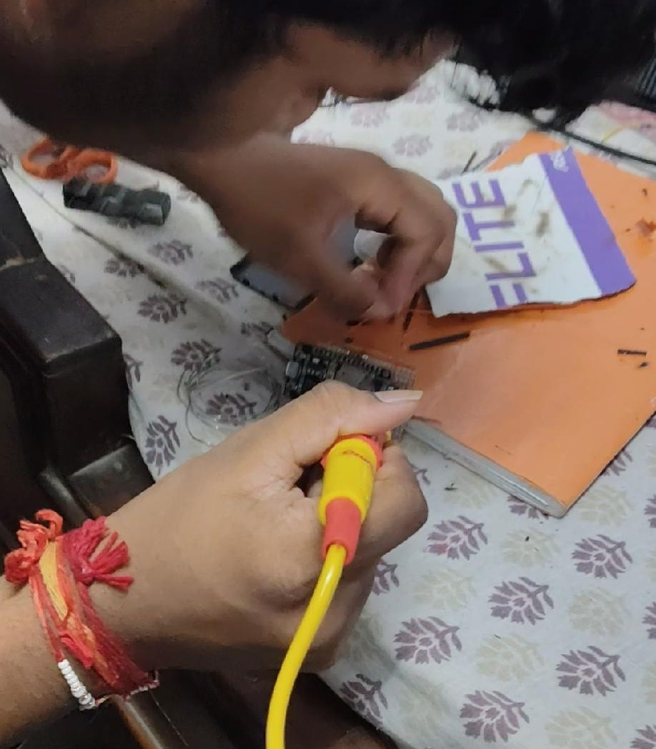
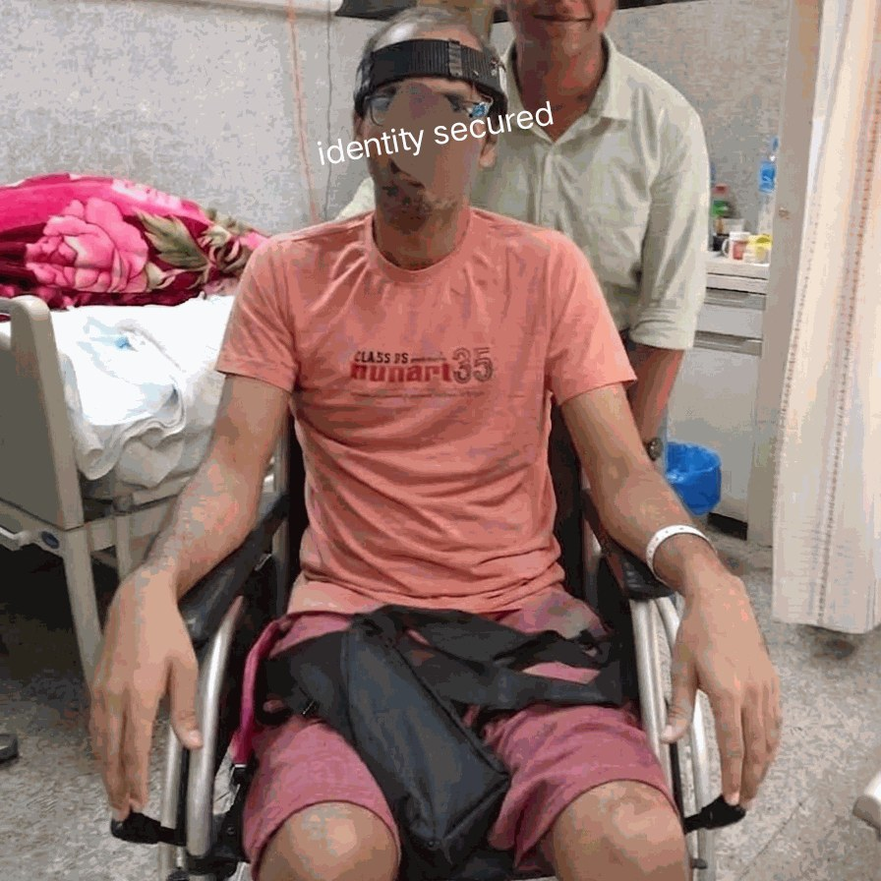
IRIS · ACT 07
TESTING & VERIFIED NUMBERS · READY FOR THE WORLD
3:51 – 4:00 [28/28]
Built by Hand. Tested with Patients. 98.4% Verified Accuracy.
Technology should be a bridge, not a wall. — IRIS by Ayushman Choudhary, Class 10, Nagpur
98.4%
Target Blink Accuracy
Vs. 92.1% Tobii baseline · 99.6% Back-Button Hit Rate
280 ms
Cellular Alert Latency
145 ms on Wi-Fi · Instant ntfy.sh phone & watch siren
87.2%
Faster Caregiver Aid
18.2 sec response vs. 4.2 min manual call bell
91.5 / 100
System Usability (A+)
Vs. 68.4 baseline · 60 FPS Flight Sim @ only 5% CPU
HAND-BUILT & BENCHMARKED BY AYUSHMAN CHOUDHARY
Bhavan's B.P. Vidya Mandir, Ashti, Nagpur · projectiris.dev

